Slide 1


How Do LLMs Work?
Unveiling the Magic Behind GPT: A Deep Dive into Language Models
Himanshu Ramchandani
Microsoft MVP

Slide 2
Himanshu Ramchandani
Agenda
- AI Problem
- Neuron, Neural Network, CNN, RNN, Transformers - What exactly is GPT?
- LLM response V/S normal Google search?
- What are LLM parameters and tokens? - Does GPT get better over time?
- How Does ChatGPT Work?

Slide 3
Himanshu Ramchandani
AI Problem 2025
2 major challenges businesses face with AI right now:
estimating and demonstrating AI value
lack of talent/skills

Slide 4
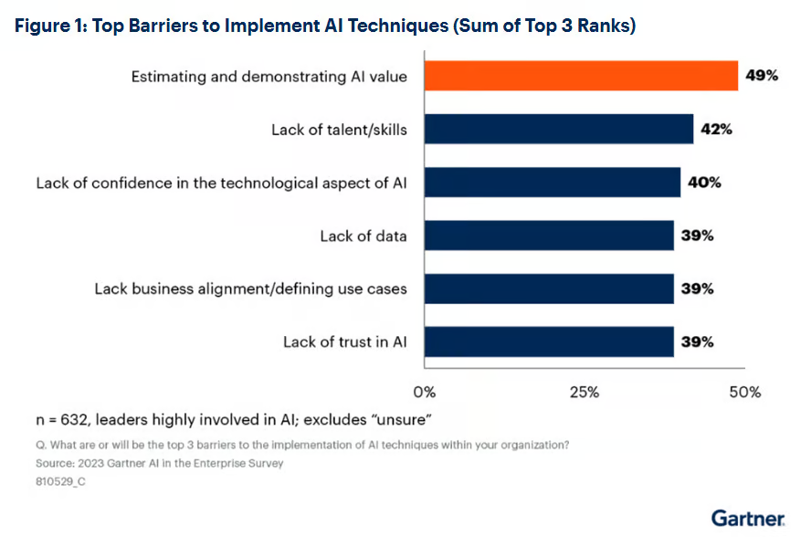

Slide 5
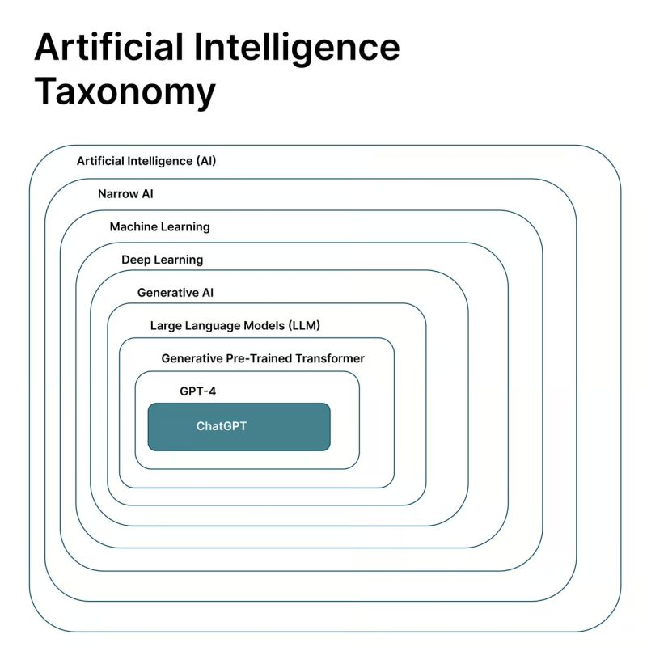

Slide 6
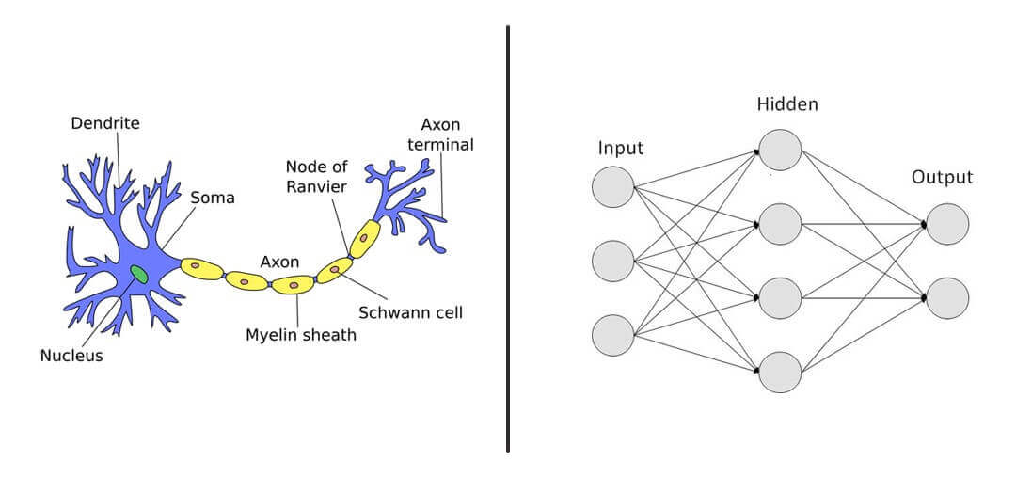
Neuron

Slide 7
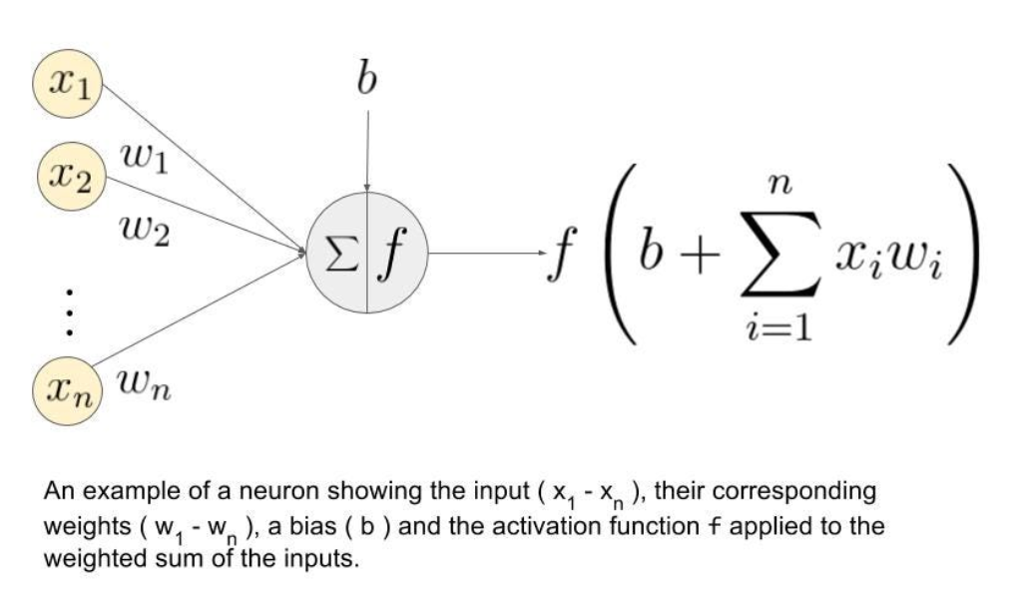
Neural Networks

Slide 8
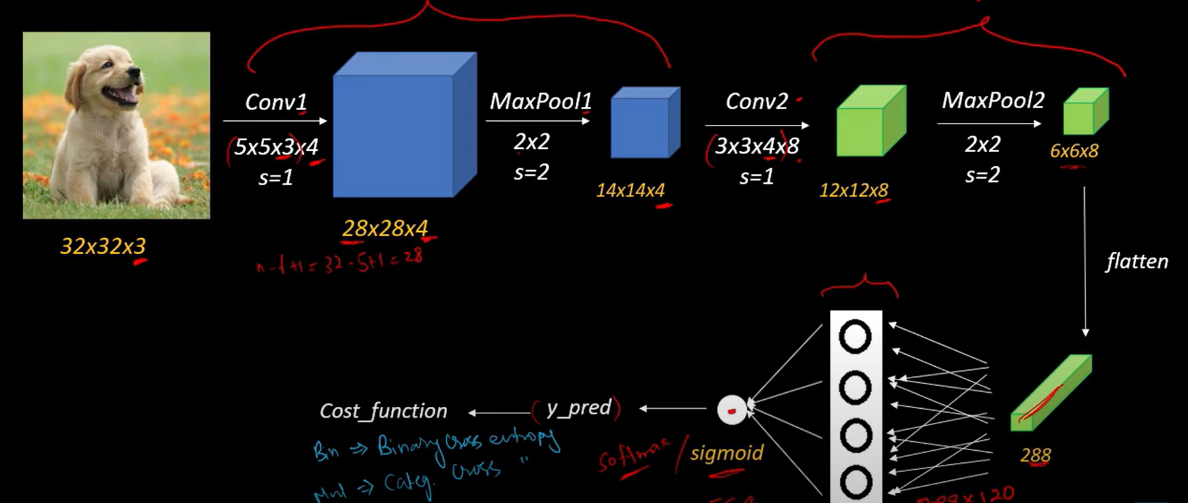
CNN (Convolutional Neural Network)

Slide 9
RNN (Recurrent Neural Network)

Slide 10
Attention Mechanism
“Himanshu is an AI consultant. He is going to solve your problems.“

Slide 11

Transformers

Slide 12
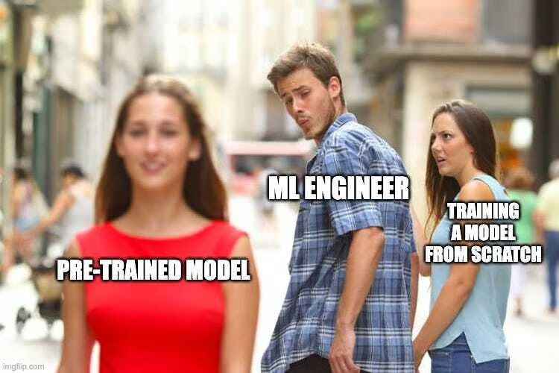
Himanshu Ramchandani
What exactly is GPT?
Generative
Pre-Trained
Transformer

Slide 13
How LLM response is different from a normal Google search?

Slide 14
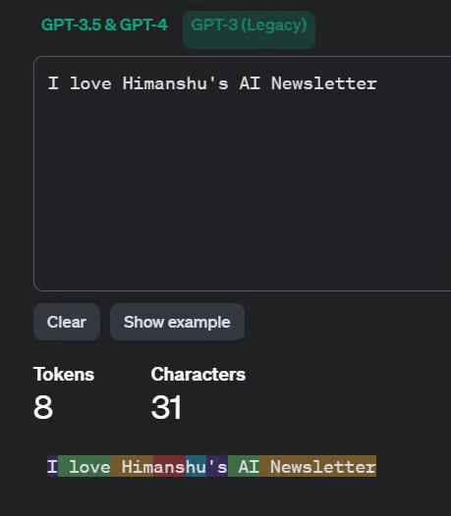
What are LLM parameters and tokens?

Slide 15
Does GPT get better over time?
GPT-3 was trained on 500 Billion tokens
175 billion parameters

Slide 16
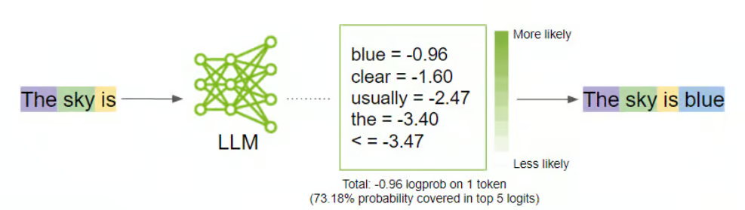
Himanshu Ramchandani
How Does ChatGPT Work?

Slide 17
Himanshu Ramchandani
How does ChatGPT generate human-like responses?
What is the capital of India?
What is the capital of China?
Response >
What is the capital of India?
What is the capital of China?
What is the capital of Sri Lanka?

Slide 18
So, ChatGPT
ChatGPT does not know anything.
It does not have self-awareness.
It does not have consciousness.

Slide 19
Key Pointers
LLMs will always start fresh
LLMs do not improve with use
To get a better response, you must adapt to LLM

Slide 20
Test Your Presence
1. What is the main difference between a Google Search and an LLM like ChatGPT?
2. What does the “T” in GPT stand for, and why is it important?
3. True or False: ChatGPT learns and improves every time you chat with it.

Slide 21
Himanshu Ramchandani
How I can help you?
Dextar - AI Engineering & Consulting Services
You are a leader? —join the Elite - an AI Leadership Accelerator
AI Engineering Bootcamp - AI Engineer HQ
AI Training for Enterprise - MasterDexter
AI Newsletter - Actionable tips to boost your AI intuition.

Slide 22
Questions?
Thank You
Himanshu Ramchandani
Microsoft MVP

